Slide 1
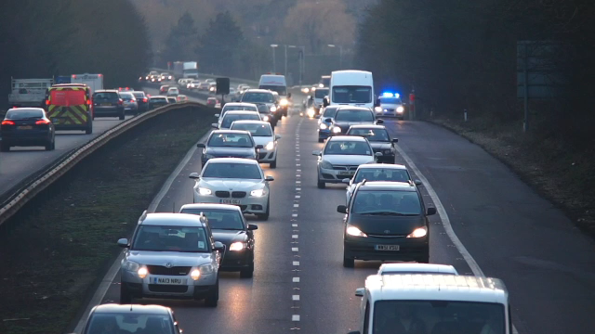
Predicting Claims Costs Using FNOL Data
Key insights and recommendations
By Maria Lisitskaya

Slide 2
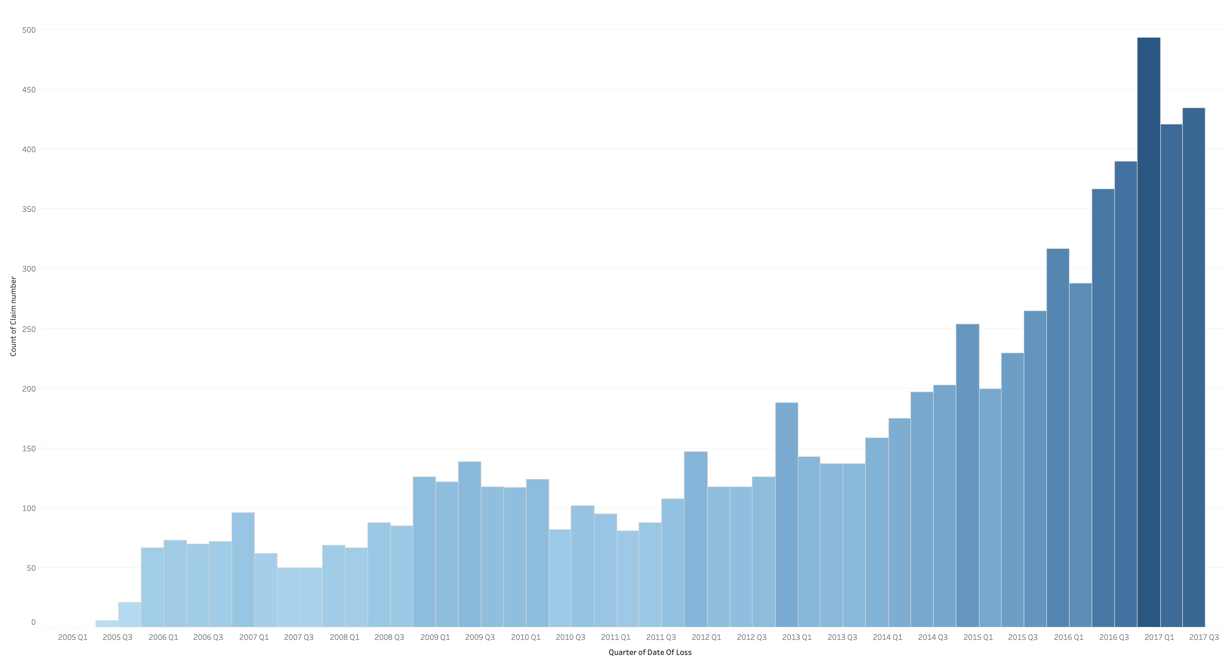
Dataset Overview & Data Suitability
01
Contains over 12 years of claims data
02
45 variables covering different aspects of claims
Notes:
Before diving into the findings, let’s first look at the dataset itself and evaluate its overall suitability for this analysis

Slide 3
Dataset Overview & Data Suitability
01
Contains over 12 years of claims data
02
45 variables covering different aspects of claims
Notes:
The dataset contains detailed information on head-on collision claims.
It spans several years, which gives us a solid foundation for trend analysis.
This is particularly important because claims behavior can change based on external factors like seasonal patterns.
Having data across multiple years allows us to smooth out short-term fluctuations and identify more stable patterns in claims costs and reporting behavior.

Slide 4
Dataset Overview & Data Suitability
01
Contains over 12 years of claims data
02
45 variables covering different aspects of claims
Notes:
The large number of variables also plays a critical role in our analysis.
With 45 variables, we have a broad set of characteristics to explore.
This allows us to dig deep into what factors impact the final claim costs, such as region, number of third-parties, or location of the incident.
Overall, the data’s depth and time span provide valuable context, allowing us to generate more reliable and insightful findings

Slide 5
Analysis Methodology
Data
cleaning
Applied formatting
Removed duplicates
Unified similar types
Cleaned corrupted data
Calculated location and time fields
Exploratory Data
Analysis
Analysed distribution of incurred claims
Correlated FNOL features (weather, notification time) with incurred costs
Feature Importance
Identified key factors affecting claims
Notes:
In this section, I'll walk you through the methodology and approach I used to analyse the dataset.
I followed a structured, step-by-step process to ensure we could extract meaningful insights from the data

Slide 6
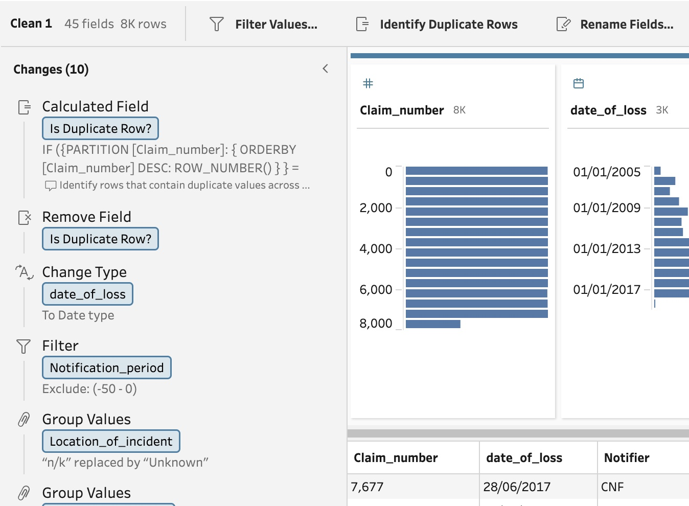

Analysis Methodology
Data
cleaning
Applied formatting
Removed duplicates
Unified similar types
Cleaned corrupted data
Calculated location and time fields
Exploratory Data
Analysis
Analysed distribution of incurred claims
Correlated FNOL features (weather, notification time) with incurred costs
Feature Importance
Identified key factors affecting claims
Notes:
The first step was data cleaning, which we performed using Tableau Prep.
Given that there were unformatted data, potential duplicates, a few corrupted values and some inconsistencies in the data, such as (“n/k”, “unknown”), we needed to address these issues.
We also standardized the data to ensure that all variables, especially those representing numerical values like 'notification period' and 'inception to loss,' were formatted consistently.

Slide 7
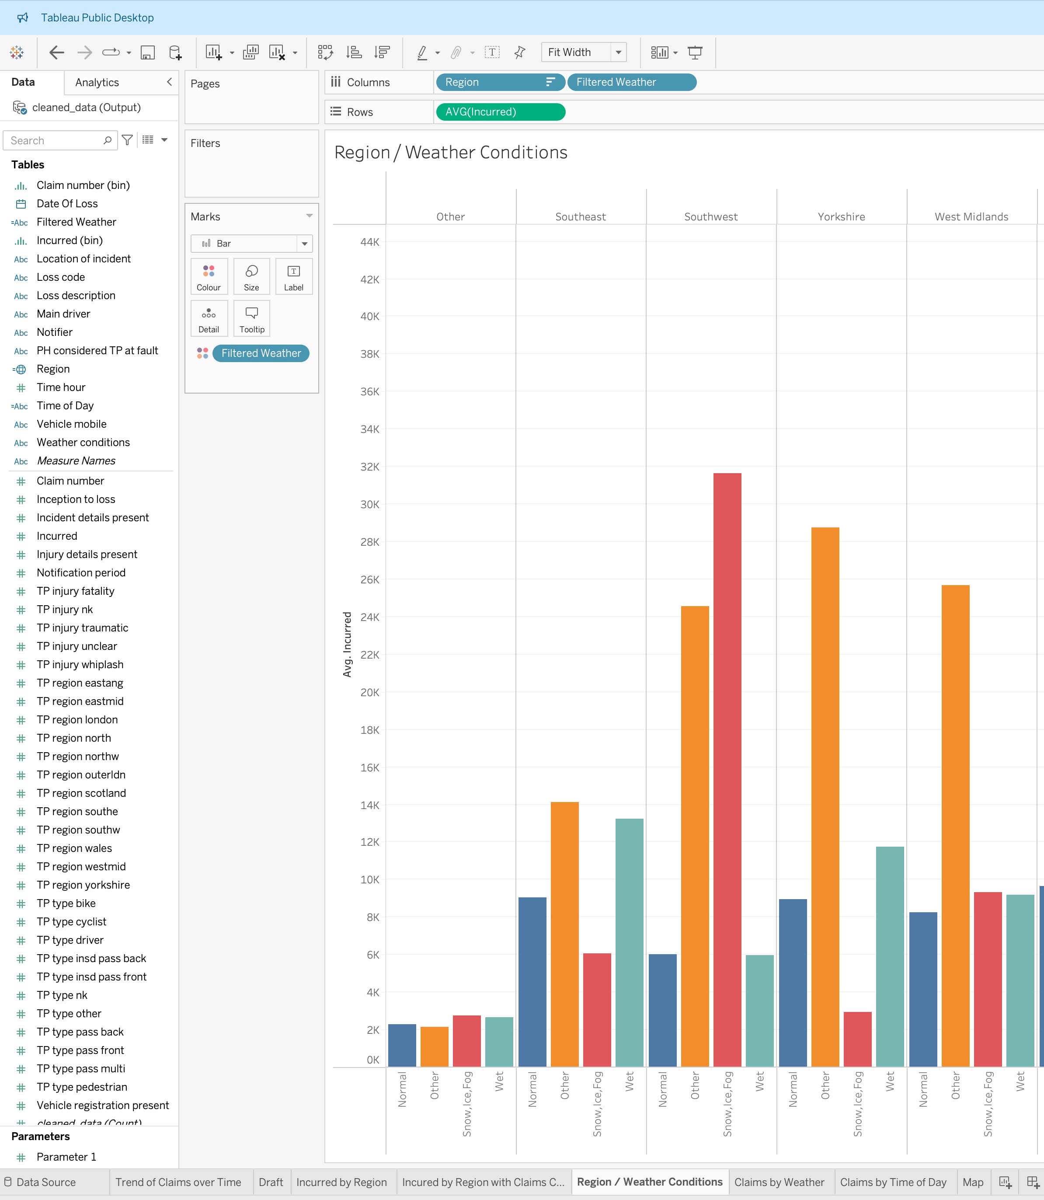

Analysis Methodology
Data
cleaning
Applied formatting
Removed duplicates
Unified similar types
Cleaned corrupted data
Calculated location and time fields
Exploratory Data
Analysis
Analysed distribution of incurred claims
Correlated FNOL features (weather, notification time) with incurred costs
Feature Importance
Identified key factors affecting claims
Notes:
Next, we performed an exploratory data analysis (or EDA) using Tableau to uncover patterns and trends within the data.
Tableau allowed us to create interactive visualizations that helped uncover trends and patterns in the data.

Slide 8
Analysis Methodology
Data
cleaning
Applied formatting
Removed duplicates
Unified similar types
Cleaned corrupted data
Calculated location and time fields
Exploratory Data
Analysis
Analysed distribution of incurred claims
Correlated FNOL features (weather, notification time) with incurred costs
Feature Importance
Identified key factors affecting claims
Notes:
After our initial analysis, we shifted focus to identifying the most influential factors.
Using Tableau's correlation and analysis tools as well as Pearson correlation coefficient between each TP_ variable and the Incurred values with help of ChatGPT.
Here, we paid special attention to variables that seemed to have a higher impact on incurred claims, which we will demonstrate further in this presentation.

Slide 9
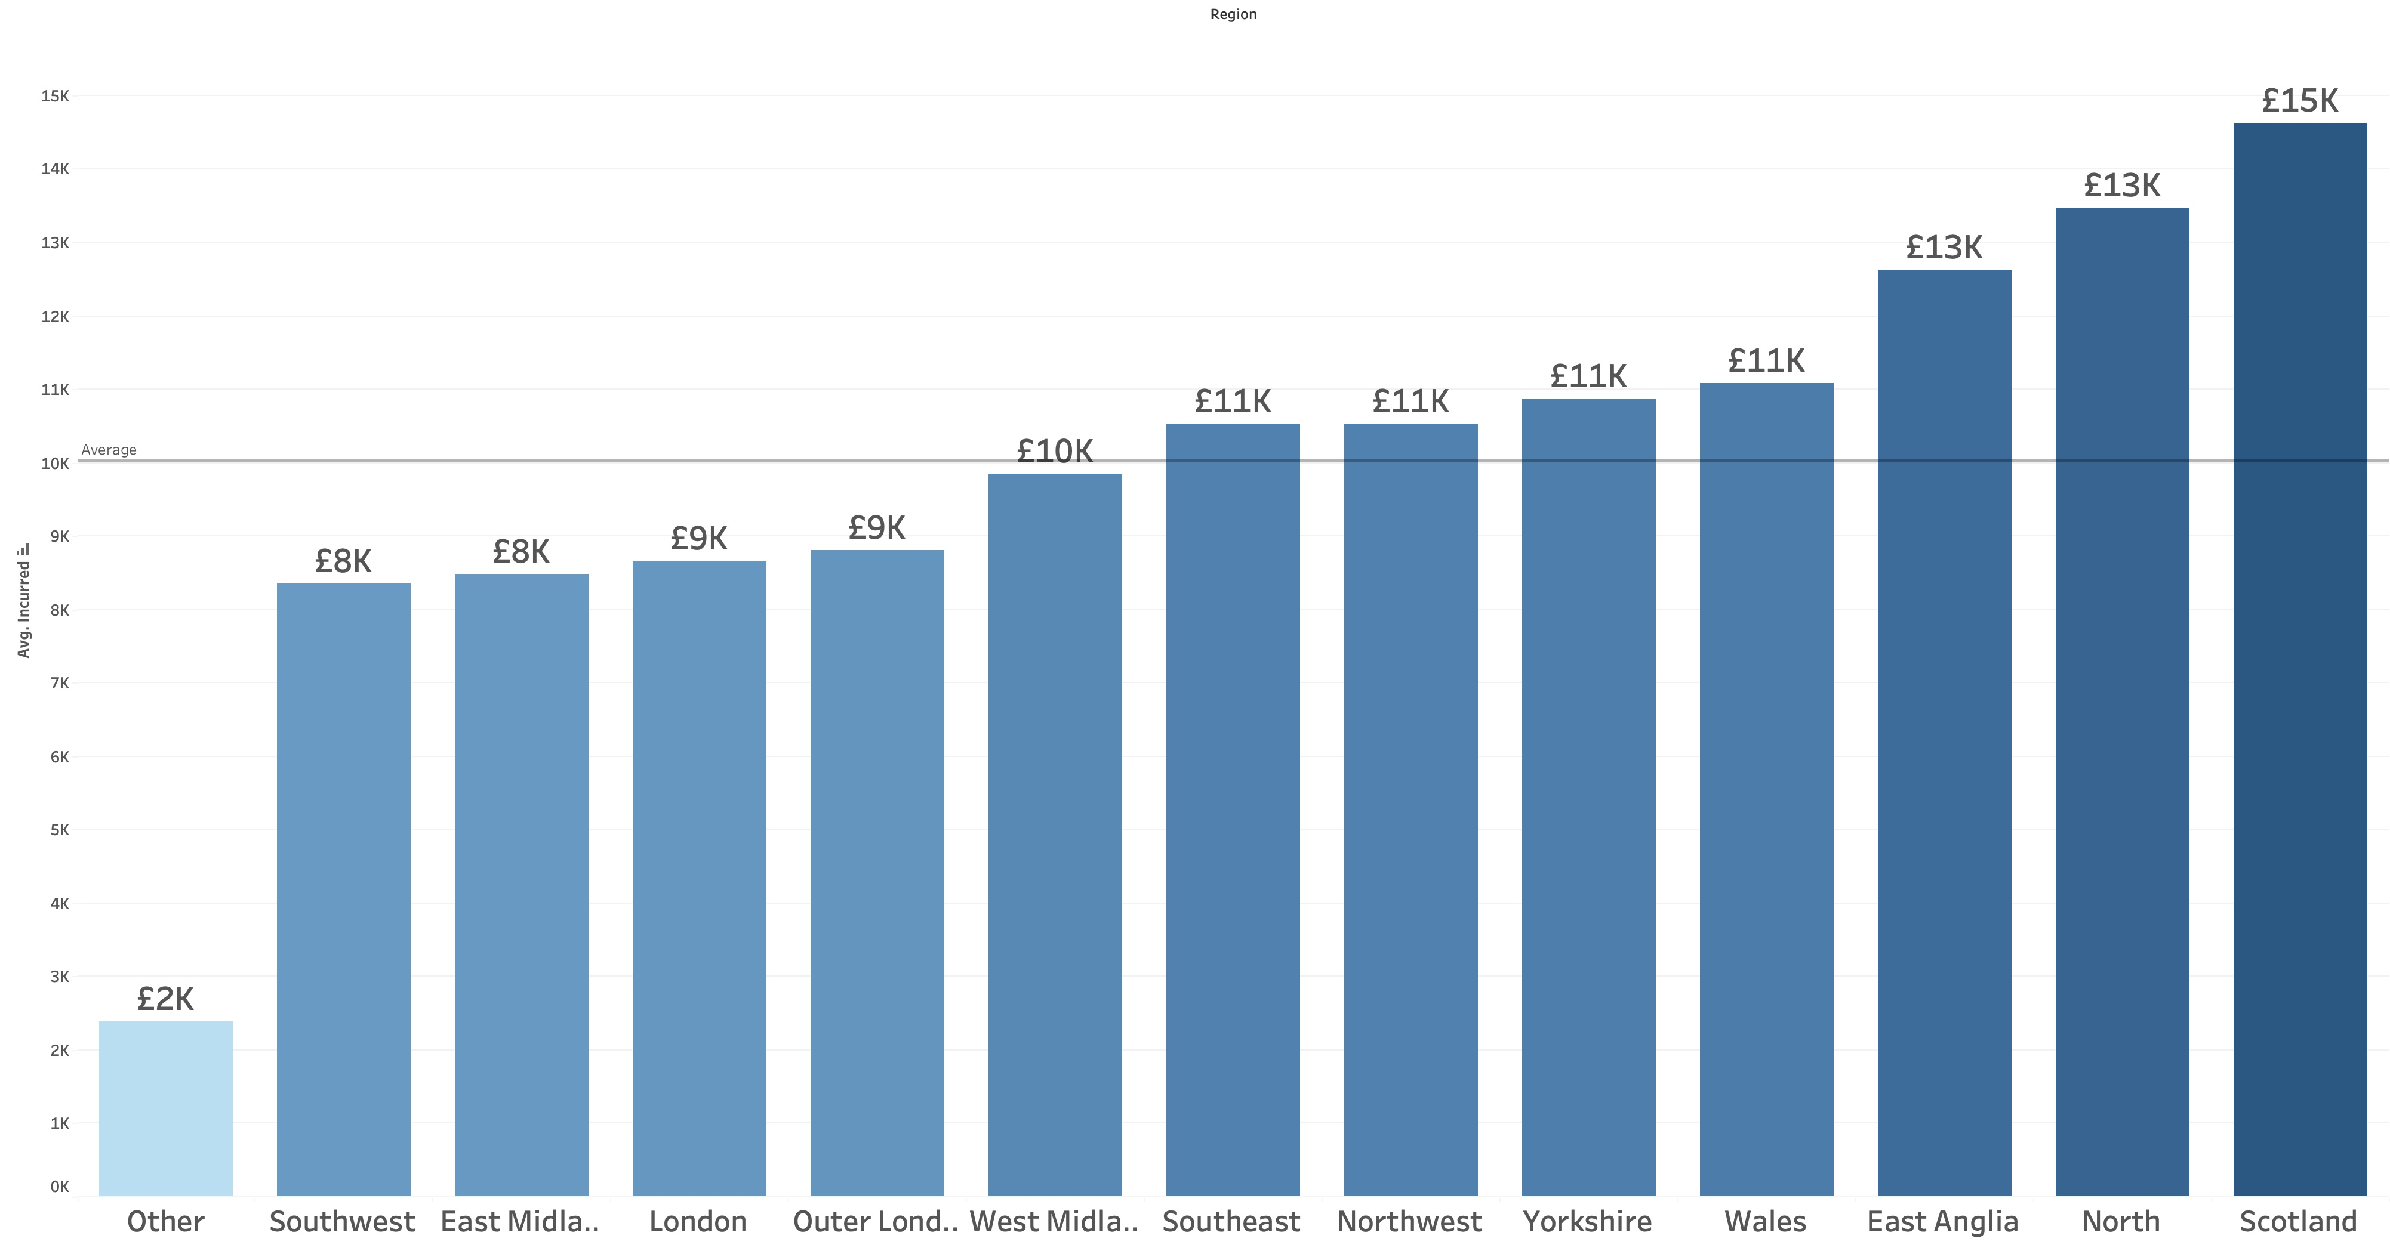
Relationship between incurred costs and region
01
Scotland has the highest incurred costs, likely due to more severe accidents or higher claim expenses.
02
North England and East Anglia, also show above-average incurred costs, while Southwest, East Midlands and London have lower costs.
Notes:
Let’s begin by looking at two important insights from the data analysis, specifically focusing on regional differences in claim costs.

Slide 10
Relationship between incurred costs and region
01
Scotland has the highest incurred costs, likely due to more severe accidents or higher claim expenses.
02
North England and East Anglia, also show above-average incurred costs, while Southwest, East Midlands and London have lower costs.
Notes:
First, we found that Scotland consistently has the highest average incurred costs across all regions.
This suggests that accidents in Scotland may either be more severe or the associated claims processes lead to higher costs.
There could be several factors contributing to this, including road conditions, regional weather patterns, or even differences in how claims are handled in this area.
It's important for us to explore these factors further, as understanding the underlying reasons could help refine our approach to both pricing and reserving in Scotland.

Slide 11
Relationship between incurred costs and region
01
Scotland has the highest incurred costs, likely due to more severe accidents or higher claim expenses.
02
North England and East Anglia, also show above-average incurred costs, while Southwest, East Midlands and London have lower costs.
Notes:
We also identified that regions like East Anglia and the North show higher-than-average incurred costs, whereas regions like the Southwest, East Midlands, and London tend to have lower average incurred costs.
The higher costs in East Anglia and the North may be driven by more severe accidents or external regional factors, while lower costs in regions like London, despite the urban density, could indicate that claims in these areas are generally less severe or involve different types of accidents.

Slide 12
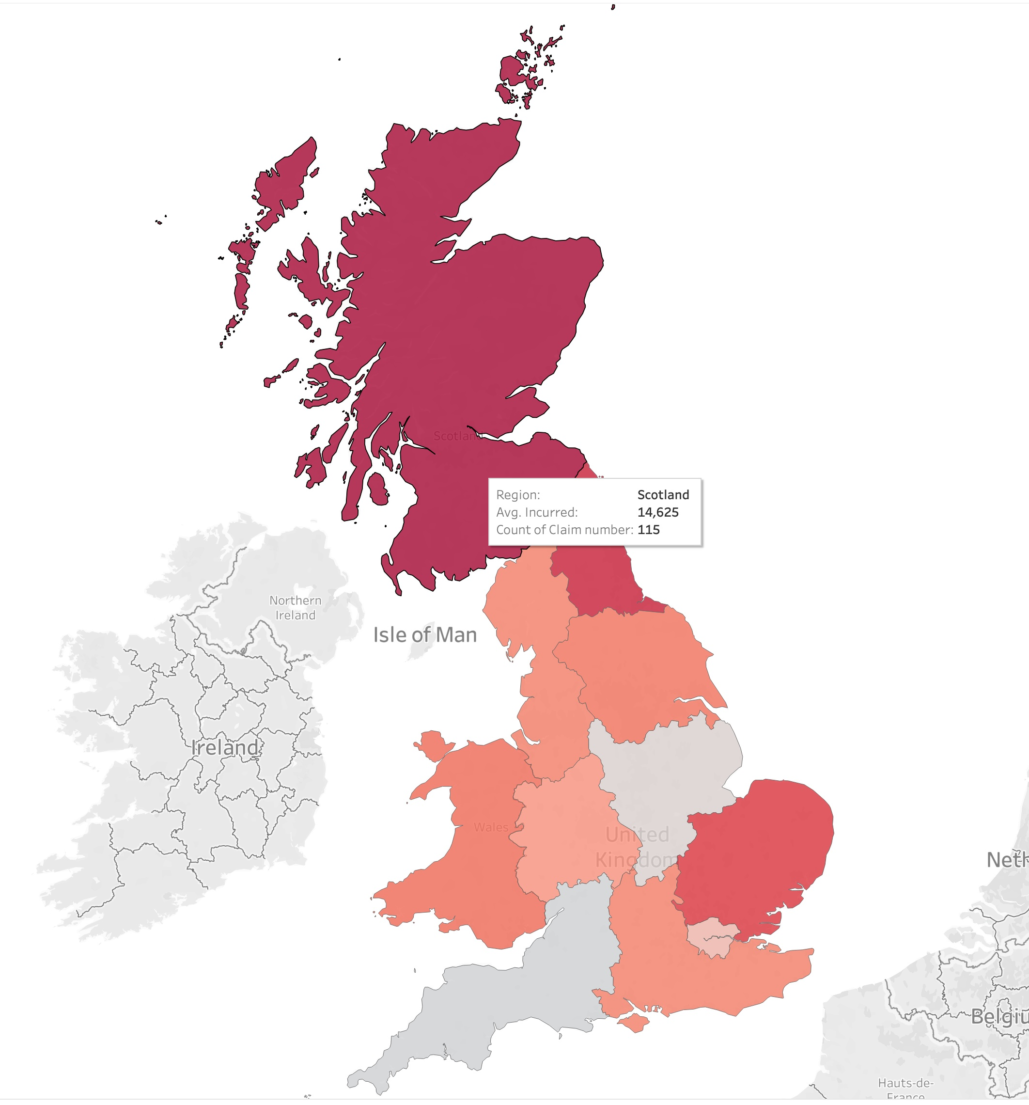
Recommendations

Slide 13
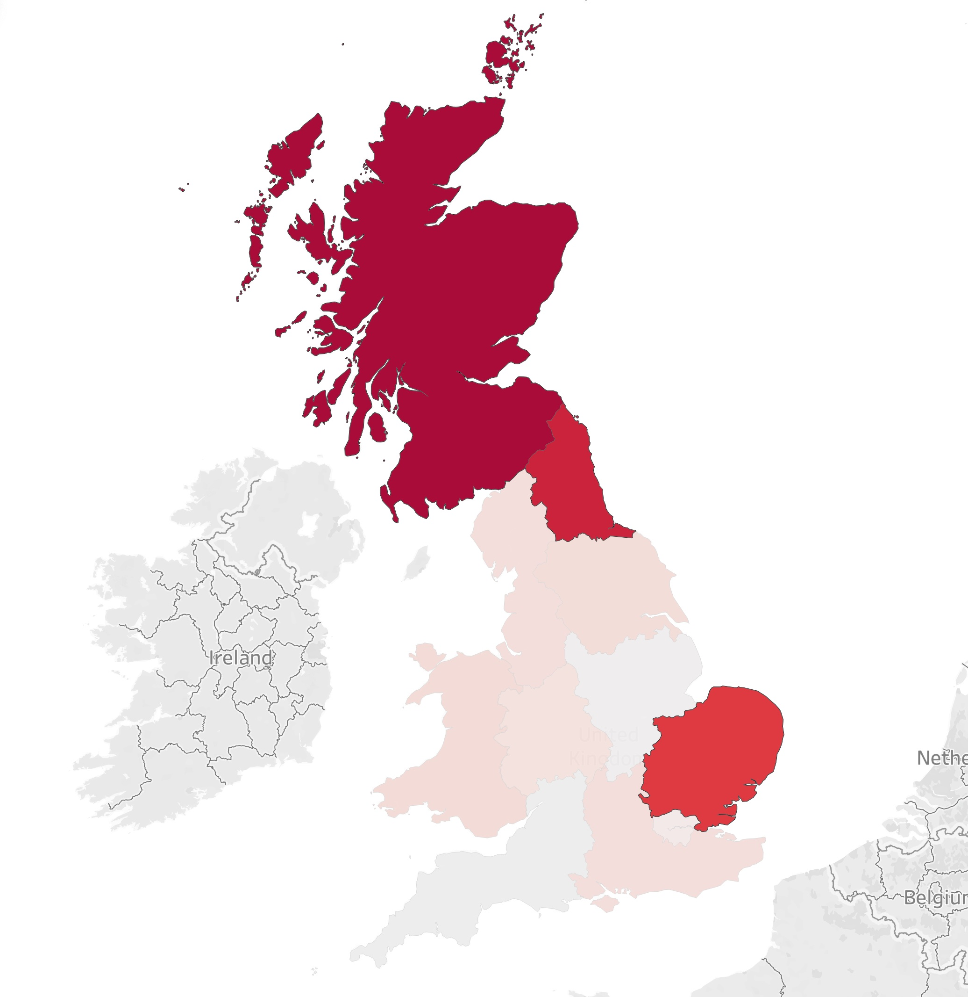
Recommendations
Increase reserves in the regions with higher incurred costs for future claims

Slide 14
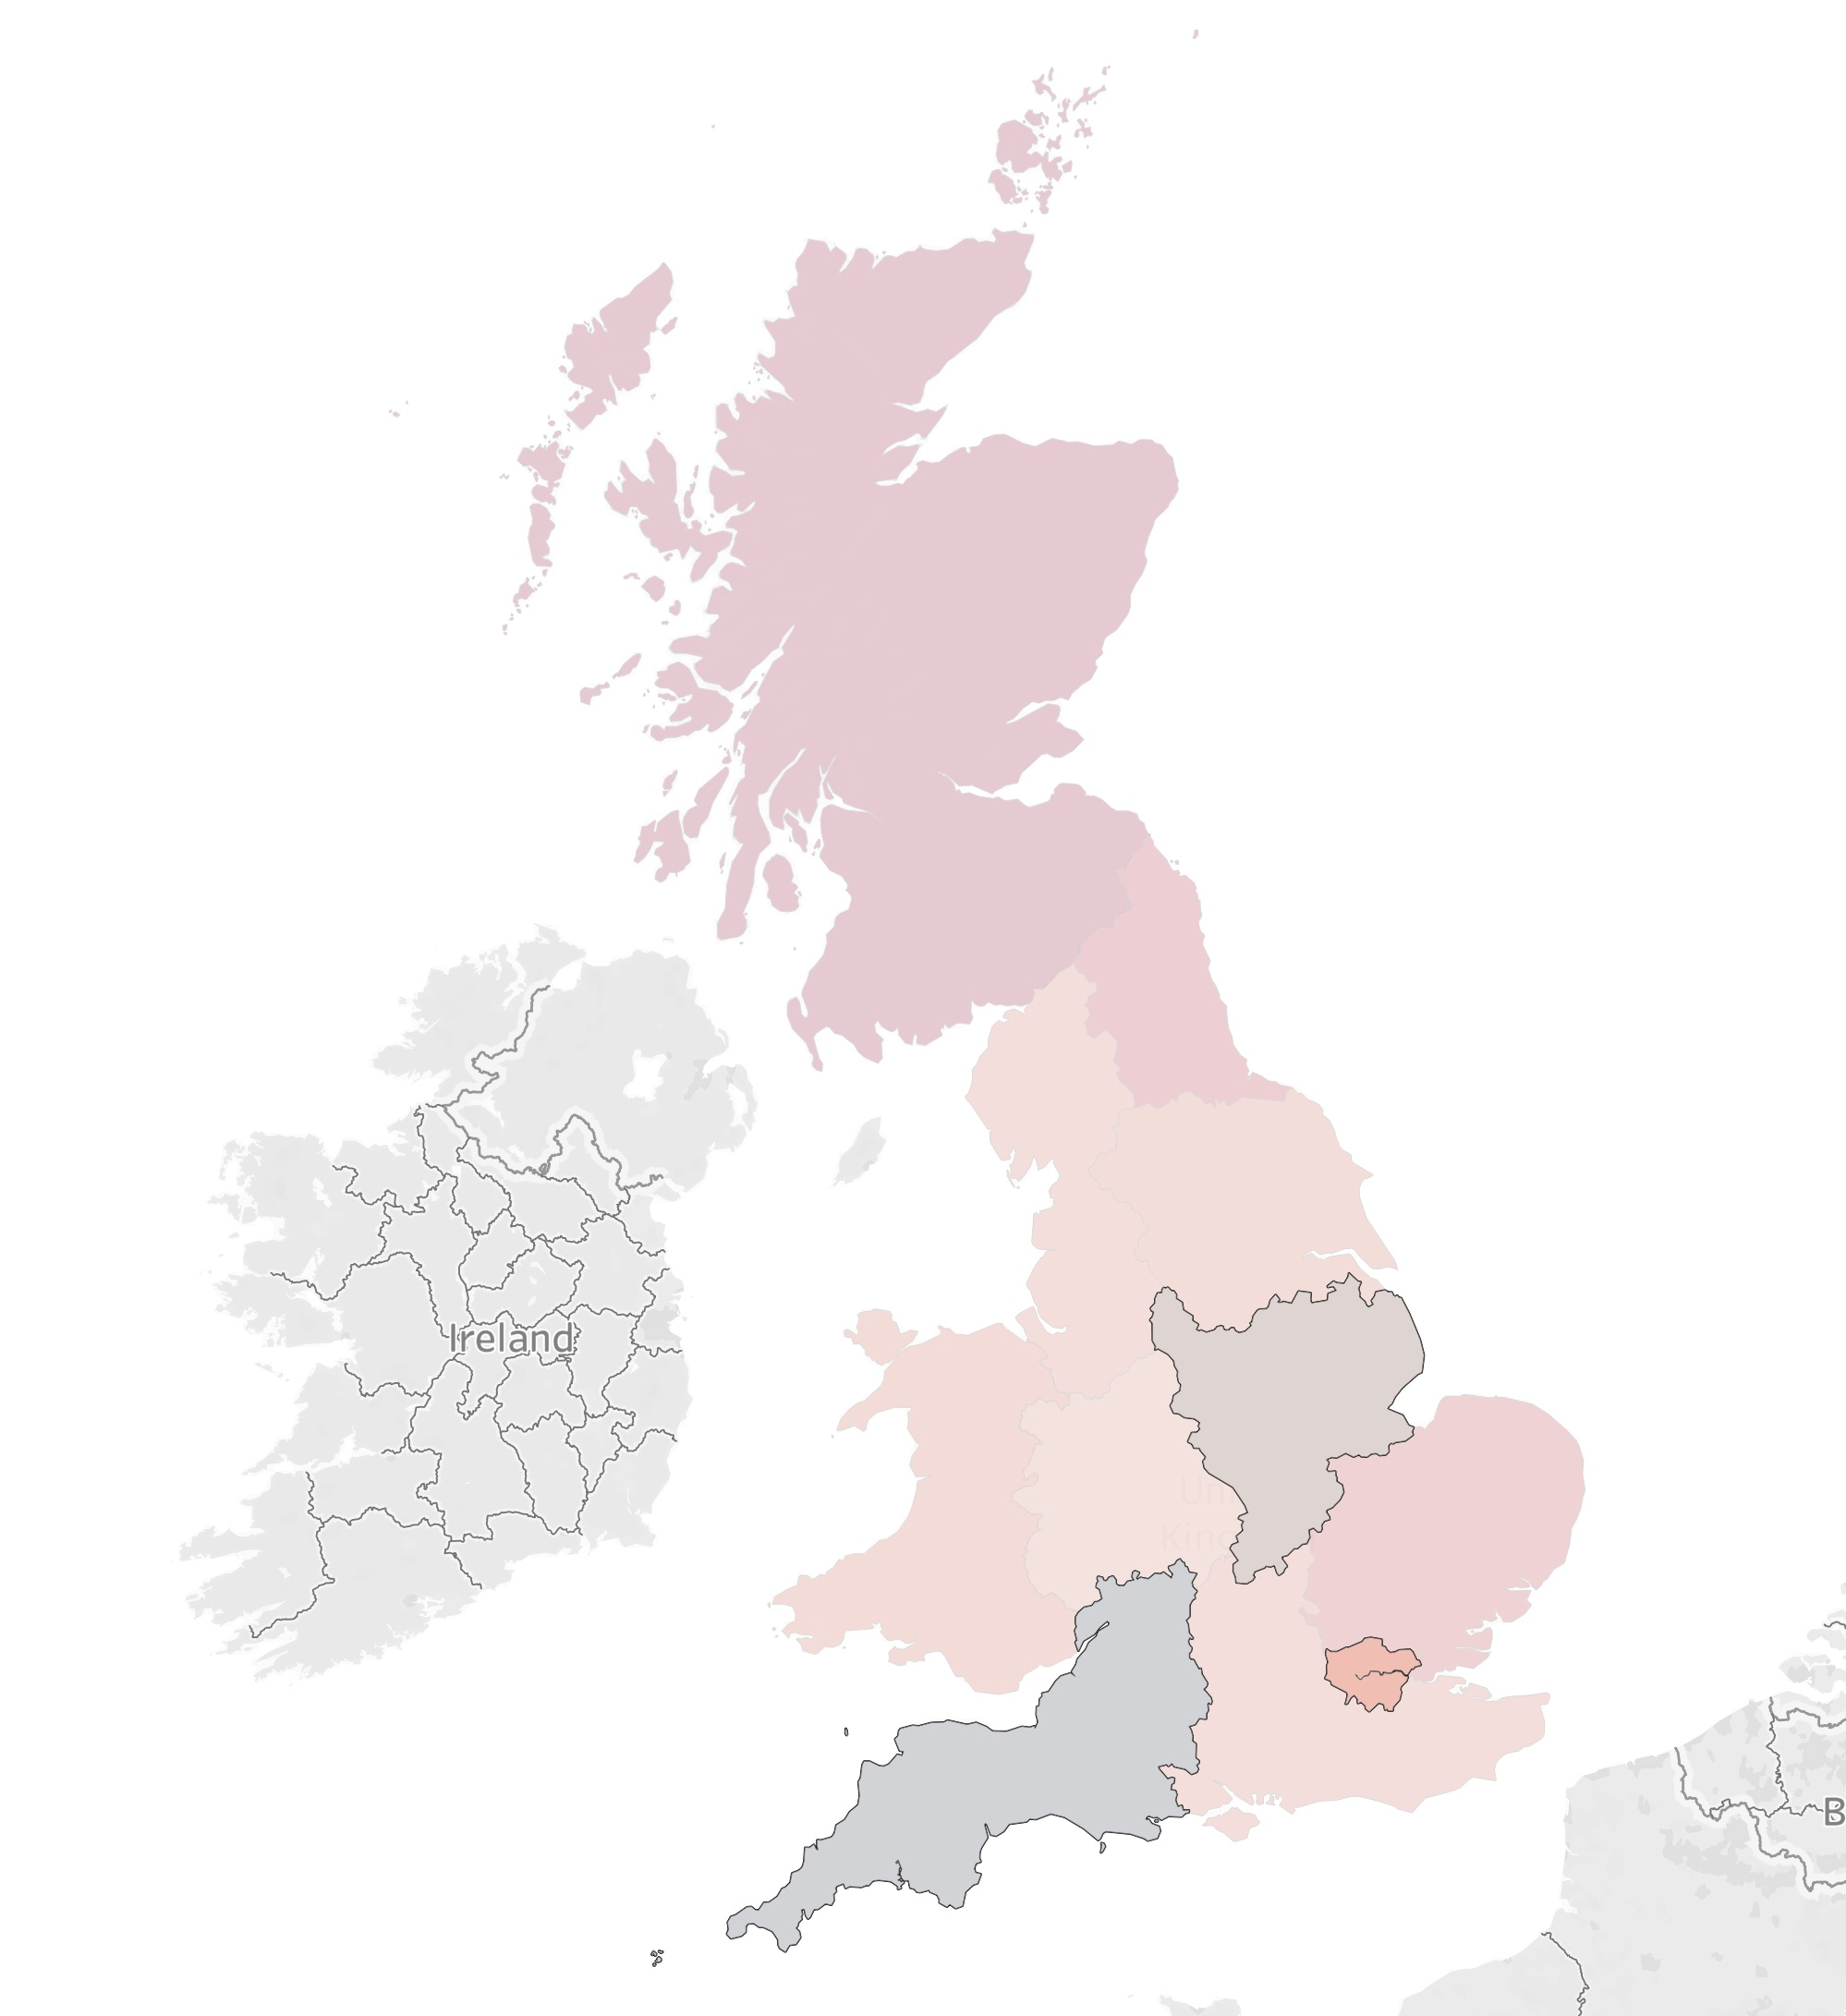
Recommendations
Increase reserves in the regions with higher incurred costs for future claims
Lower reserves in regions with consistently lower below-average incurred costs, freeing up resources for other regions

Slide 15
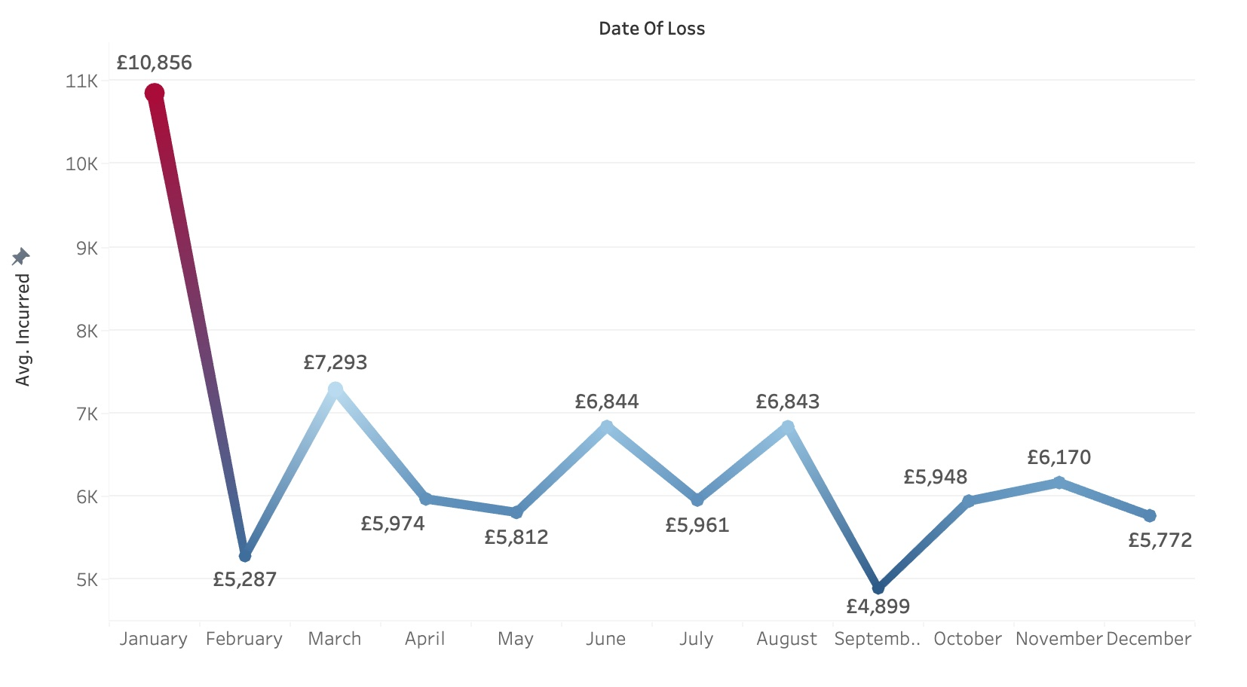
Relationship between incurred costs and month of year
01
Early months show higher claim values, likely due to winter condition and increased traffic
01
There is a slight positive correlation between Annual leave and employee has and the bonus they earn
02
02
Claims fluctuate throughout the year, suggesting seasonal factors impact costs
(such as holidays)
Longer hours of annual leave lets the employees become more motivated for bigger bonuses
Notes:
Now, let’s talk about some interesting patterns we’ve observed in the time-based analysis of claims. Specifically, we identified a repeating trend in claim values over the months of the year.

Slide 16
Relationship between incurred costs and month of year
01
Early months show higher claim values, likely due to winter condition and increased traffic
01
There is a slight positive correlation between Annual leave and employee has and the bonus they earn
02
02
Claims fluctuate throughout the year, suggesting seasonal factors impact costs
(such as holidays)
Longer hours of annual leave lets the employees become more motivated for bigger bonuses
Notes:
Insight 1 reveals that the early part of the year, particularly between January and March, tends to show slightly higher incurred values compared to the rest of the year.
One likely explanation is weather-related factors, such as hazardous winter driving conditions, or even holiday-related traffic increases around New Year’s.
This seasonal spike in claims aligns with higher risk periods where the external environment could be a contributing factor.

Slide 17
Relationship between incurred costs and month of year
01
Early months show higher claim values, likely due to winter condition and increased traffic
01
There is a slight positive correlation between Annual leave and employee has and the bonus they earn
02
02
Claims fluctuate throughout the year, suggesting seasonal factors impact costs
(such as holidays)
Longer hours of annual leave lets the employees become more motivated for bigger bonuses
Notes:
In Insight 2, we see that these fluctuations are consistent with the idea that claim costs tend to vary throughout the year.
Not only does the early part of the year see higher claims, but there are other fluctuations that hint at time-based influences, such as seasonal traffic patterns and changes in weather conditions.
Understanding this kind of variation is essential for improving our forecasting capabilities and enhancing future pricing decisions.

Slide 18
Recommendations

Slide 19
Recommendations
Increase reserves in early months (Jan–Mar) due to higher claims during winter.

Slide 20
Recommendations
Increase reserves in early months (Jan–Mar) due to higher claims during winter.
Maintain a buffer for peak periods, like holidays and winter months.

Slide 21
Recommendations
Increase reserves in early months (Jan–Mar) due to higher claims during winter.
Maintain a buffer for peak periods, like holidays and winter months.
Use a dynamic reserving model that adjusts reserves based on monthly trends.

Slide 22
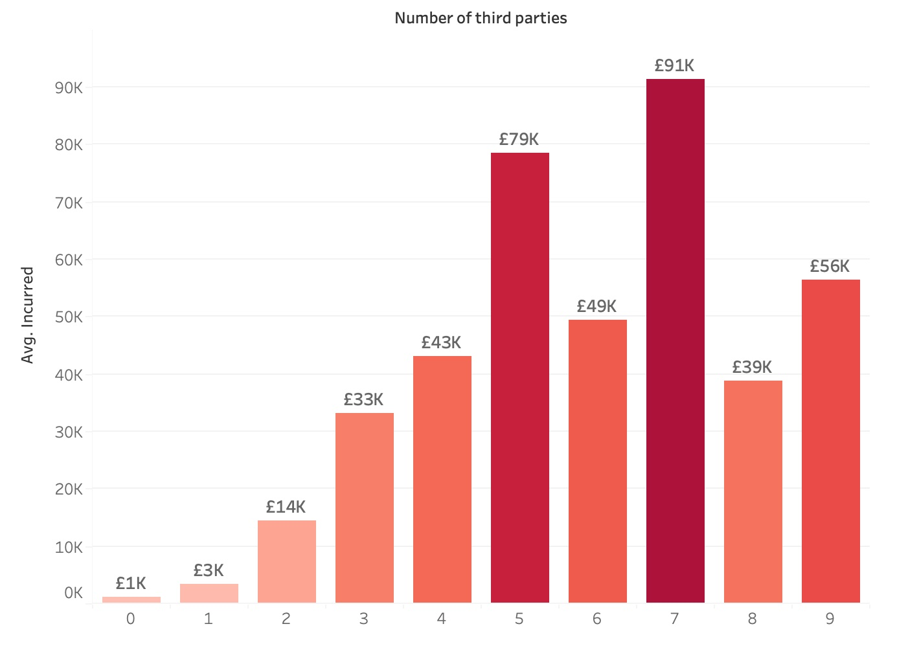
Impact of Third-Party Involvement on Incurred Costs
01
The involvement of third parties significantly increases incurred claim costs.
02
Factors such as increased liability, litigation, or compensating multiple individuals contribute to higher costs.
03
The largest jump in costs is observed when three or more third parties are involved in the claim.
Notes:
Now, let’s take a closer look at how third-party involvement affects claims costs

Slide 23
Impact of Third-Party Involvement on Incurred Costs
01
The involvement of third parties significantly increases incurred claim costs.
02
Factors such as increased
liability, litigation, or compensating multiple individuals contribute to higher costs.
03
The largest jump in costs is observed when three or more third parties are involved in the claim.
Notes:
As we analyse the data, one of the clearest trends we observe is that third-party involvement significantly drives up incurred claim costs.
When third parties—such as other drivers, pedestrians, or passengers—are involved in an accident, the claims process becomes more complex.

Slide 24
Impact of Third-Party Involvement on Incurred Costs
01
The involvement of third parties significantly increases incurred claim costs.
02
Factors such as increased
liability, litigation, or compensating multiple individuals contribute to higher costs.
03
The largest jump in costs is observed when three or more third parties are involved in the claim.
Notes:
This complexity could be due to several factors: increased liability, the potential for litigation, or the need to compensate multiple individuals for damages.
All of these factors contribute to a higher financial burden on the insurer.

Slide 25
Impact of Third-Party Involvement on Incurred Costs
01
The involvement of third parties significantly increases incurred claim costs.
02
Factors such as increased
liability, litigation, or compensating multiple individuals contribute to higher costs.
03
The largest jump in costs is observed when three or more third parties are involved in the claim.
Notes:
The more third parties involved, the higher the claim costs.
While there are exceptions, the overall trend shows that as the number of third parties rises, so does the financial impact.
The steepest increase in average claim costs is observed when three or more third parties are involved, indicating a notable shift in financial risk.

Slide 26
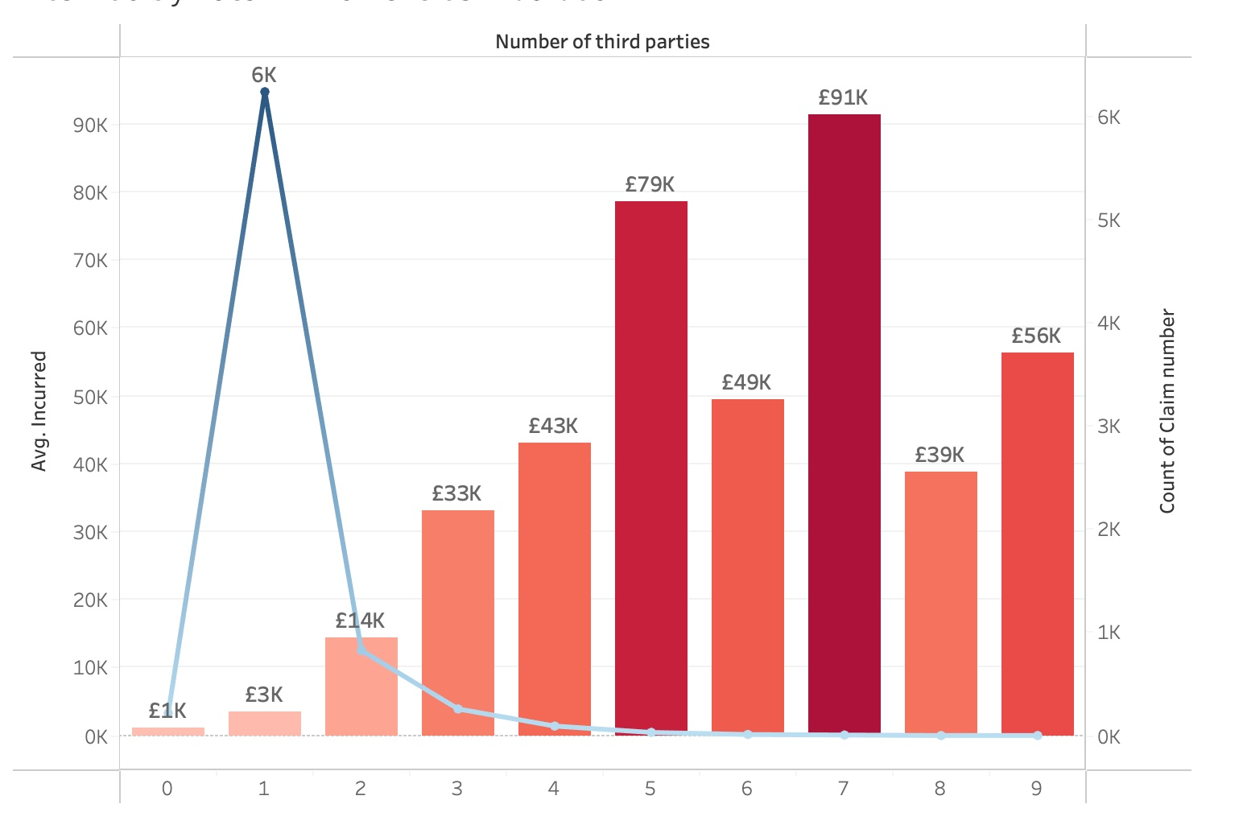
Despite being less frequent, claims with three or more third-parties bring significantly higher costs, making them essential for accurate reserving decisions
Impact of Third-Party Involvement

Slide 27
Despite being less frequent, claims with three or more third-parties bring significantly higher costs, making them essential for accurate reserving decisions
Impact of Third-Party Involvement
Notes:
Although claims involving three or more third parties are less frequent, they carry significantly higher costs. This makes them critical to focus on when making accurate reserving decisions. These claims, due to their complexity and higher financial impact, must be accounted for carefully in risk models and pricing strategies to ensure the company can cover the larger payouts associated with them

Slide 28
Recommendations

Slide 29
Recommendations
Increase reserves for Multi-Party Claims:
Allocate higher reserves for claims with multiple third parties based on historical cost trends.

Slide 30
Recommendations
Increase reserves for Multi-Party Claims:
Allocate higher reserves for claims with multiple third parties based on historical cost trends.
Risk-Based Premium Adjustments:
Adjust premiums for policies with higher likelihood of third-party involvement (e.g., commercial vehicles).

Slide 31
Recommendations
Increase reserves for Multi-Party Claims:
Allocate higher reserves for claims with multiple third parties based on historical cost trends.
Risk-Based Premium Adjustments:
Adjust premiums for policies with higher likelihood of third-party involvement (e.g., commercial vehicles).
Third-Party Claims Monitoring:
Implement early detection of high-risk claims to adjust reserves and pricing accordingly.

Slide 32
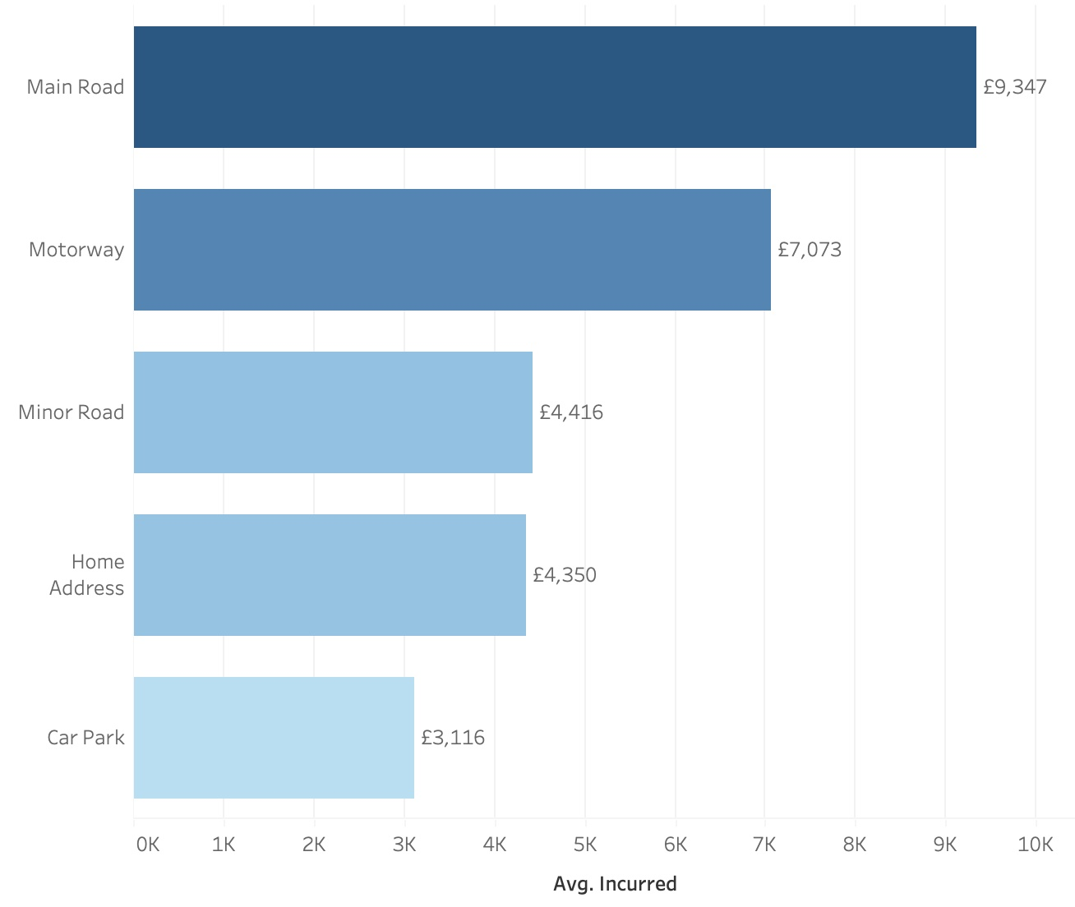
Relationship between location and incurred costs
01
Average incurred costs are higher for Main Roads and Motorways.
02
Main Roads and Minor Roads show greater variability in claim costs, indicating more unpredictable outcomes.
Notes:
The location of an accident significantly affects both the severity and the cost of claims, making it a key factor in predicting and managing reserves.
Why It’s Important: Accidents on main roads and motorways involve higher speeds and traffic, often resulting in more severe claims and higher costs. Understanding these patterns allows for better pricing and reserving strategies.
Impact on Claims:
Main roads and motorways show higher average incurred costs, reflecting the increased severity of accidents in these areas.
Both main roads and minor roads show greater variability in claims, making costs in these areas more unpredictable.

Slide 33
Relationship between location and incurred costs
01
Average incurred costs are higher for Main Roads and Motorways.
02
Main Roads and Minor Roads show greater variability in claim costs, indicating more unpredictable outcomes.
Notes:
Main roads and motorways have the highest average costs, indicating more severe claims.
Minor roads have lower average costs but remain unpredictable.
Key Insight: Accidents on main roads and motorways lead to higher costs, while main and minor roads show more variability, requiring careful attention when setting reserves.

Slide 34
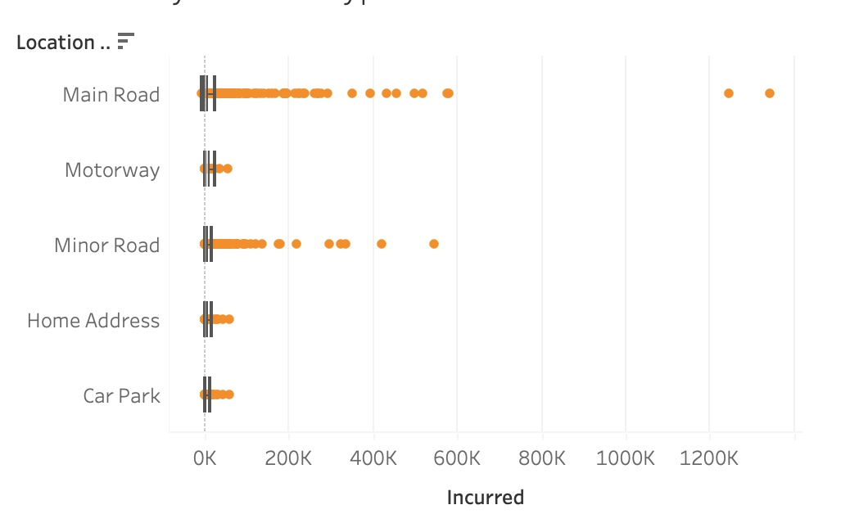
Relationship between location and incurred costs
01
Average incurred costs are higher for Main Roads and Motorways.
02
Main Roads and Minor Roads show greater variability in claim costs, indicating more unpredictable outcomes.
Notes:
Main roads and minor roads show a wider spread of incurred costs, meaning more unpredictable outcomes.
Motorways have higher but more consistent costs.
The variability of claims on main and minor roads requires conservative reserving, while motorways, despite higher costs, allow for more predictable planning.

Slide 35
Recommendations

Slide 36
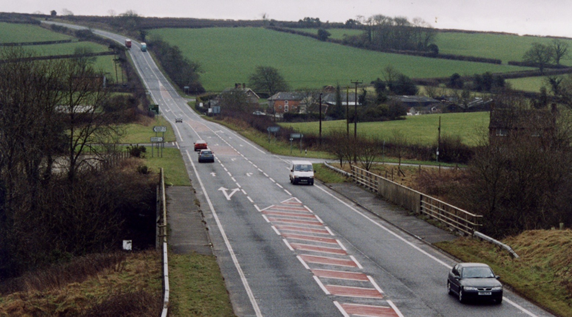
Recommendations
Increased Reserves for Major Roads:
Allocate higher reserves for claims on Major Roads, as they tend to result in more costly and unpredictable claims.

Slide 37
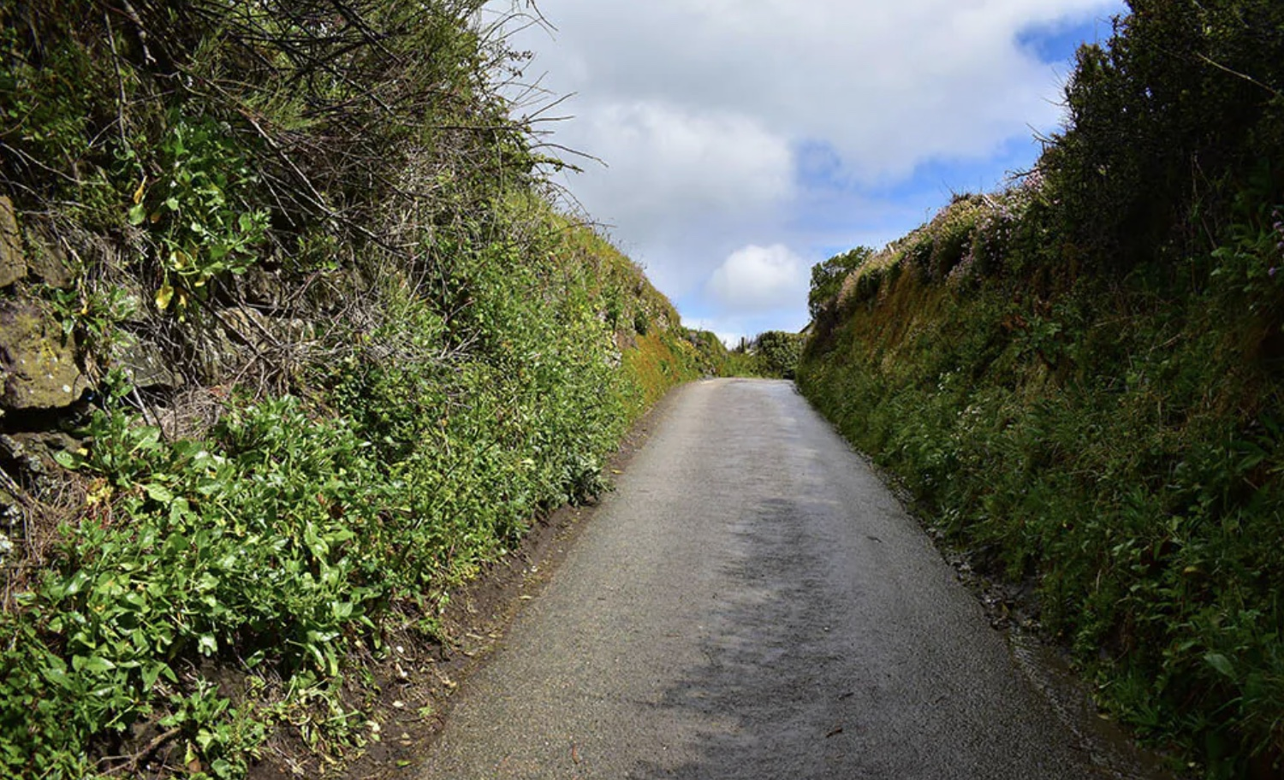
Recommendations
Increased Reserves for Major Roads:
Allocate higher reserves for claims on Major Roads, as they tend to result in more costly and unpredictable claims.
Dynamic Reserves for Minor Roads:
Maintain flexible reserves for Minor Roads to account for occasional large claims despite lower average costs.

Slide 38

Thank you for your attention!
Maria Lisitskaya
Data Analyst
mlisitskaya@yahoo.com

